Slide 1
SIGN LANGUAGE RECOGNITION USING GRAPH AND DEEP NEURAL NETWORK BASED ON LARGE SCALE DATASET
BHAGYA A JAI
B21CSB18
14 AUGUST 2024

Slide 2
OVERVIEW
INTRODUCTION
LITERATURE REVIEW
PROBLEM REVIEW
OBJECTIVES
METHODOLOGY
DATASETS
RESULTS
CONCLUSION
REFERENCES

Slide 3
INTRODUCTION
SIGN LANGUAGE : A KEY COMMUNICATION TOOL
Essential for the hearing-impaired
Uses facial, body, and hand gestures.
CHALLENGES FACED
COMPLEXITY IN LEARNING
LACK OF INTEREST
VARIATIONS ACROSS REGIONS

Slide 4
Automatic Sign Language Translator
Types of signs
Static
Dynamic
Data collection methods
Sensor based system
Vision based system
Image based
Skeleton based

Slide 5
Automatic Sign Language Translator contd..
Graph Convolutional network
Consider motion and temporal features
Whole body Information
Facial pose
Hand pose
Body pose
Large datasets

Slide 6
PROPOSED GCAR SYSTEM
Innovative Approach: Captures spatial-temporal information.
Two stream model: Processes joint key features , processes joint motion , combines for classification.
Performance: High accuracy on benchmark datasets.
Impact: Sets new standard in SLR and improve generalization and real-time use

Slide 7
LITERATURE REVIEW
AUTHOR | DESCRIPTION OF THE WORK
Miah et al | Applied CNN model on segmented ASL dataset; achieved good performance compared to existing systems.
Put et al | Proposed a multi-stage technique: Connectionist Temporal Classification (CTC) and 3D Convolutional Residual Network (3D-ResNet) with LSTM; achieved WER of 36.7% and 32.7% for CSL and RWTHPHOENIX-Weather datasets.
Koller et al | Integrated CNN and HMM features; applied CNN-HMM hybrid model, reducing WER by 20% on three benchmark datasets.
Huang et al | Introduced a model extracting spatial-temporal features using 3D-CNN and attention model; achieved 95.30% accuracy on ChaLearn dataset.

Slide 8
PROBLEM REVIEW
The following issues are being addressed :
COMMUNICATION GAP
LEARNING COMPLEXITY
CURRENT LIMITATIONS
INCOMPLETE GESTURE RECOGNITION
DATASET LIMITATIONS

Slide 9
OBJECTIVES
Develop a two-stream model utilizing multistage graph convolution with attention and residual connection (GCAR) to extract spatial-temporal contextual information for sign language recognition.
SIMPLIFY LEARNING
ENHANCE COMMUNICATION
LEVERAGE LARGE SCALE DATASETS
OVERCOME SYSTEM LIMITATIONS
COMPREHENSIVE RECOGNITION

Slide 10
METHODOLOGY
MODEL ARCHITECTURE
Input Pose Sequence
Sequence of input pose: X_{(1:N)} =[x₁,x₂,x₃,...,x_{N}]
X_{i} ​∈ R^{K}, concatenated skeleton key points in dimension K.
Two Stream Model
Stream 1: Processes joint skeleton points.
Stream 2: Processes joint motion
Creation of the final feature for classification

Slide 11
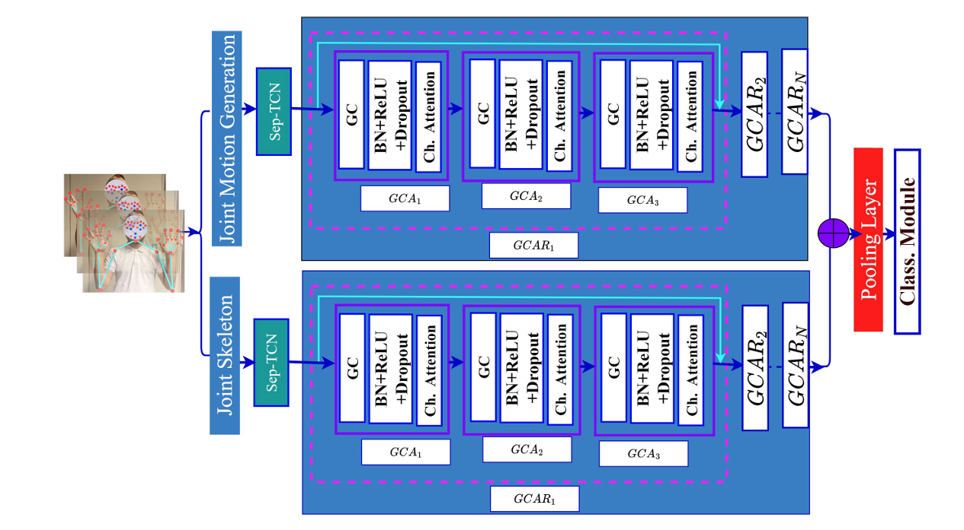

Slide 12
COMPONENTS OF THE TWO-STREAM MODEL
POSE ESTIMATION
MOTION CALCULATION
SEPARABLE TCN
GRAPH CONVOLUTION WITH ATTENTION (GCA) MODULE
GRAPH CONSTRUCTION
GRAPH CONVOLUTION
CHANNEL ATTENTION
MULTI-STAGE OF GRAPH CONVOLUTION WITH ATTENTION AND RESIDUAL CONNECTION (GCAR) APPROACH
CLASSIFICATION MODULE

Slide 13
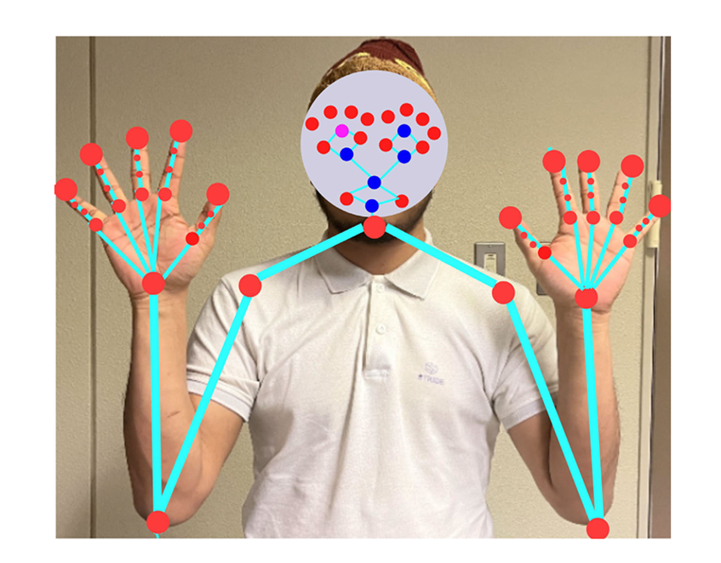
A.POSE ESTIMATION
Uses skeletal information
Hide important human details
Protects privacy and security
67 skeleton points used
47 from hands
20 from face
5 from body

Slide 14
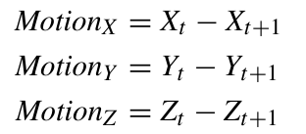
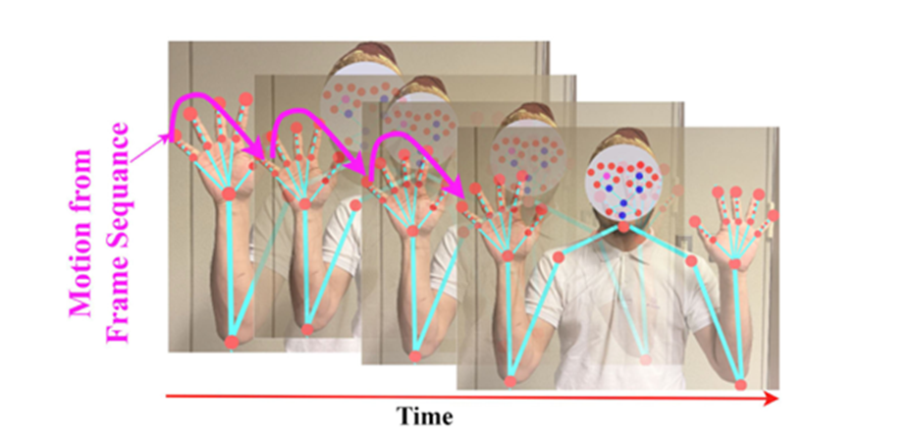
B.MOTION CALCULATION
For dynamic sign language recognition
Enhance feature extraction
Extract motion from framing sequences before GC model input.
Calculate vectors using x, y, and z coordinates of 67 skeleton points.
Compute joint position differences between consecutive frames.

Slide 15
C.SEPARABLE TCN
A variant of Temporal Convolutional Networks (TCN)
Depth wise Separable TCN.
Enhanced efficiency and performance
Conventional TCN Issue: High computation costs due to numerous multiplication operations.

Slide 16
SEPARABLE TCN contd…
Separable TCN Approach:
Depth-Wise (DW) Convolution
Point-Wise (PW) Convolution
Result:Reduced operations per kernel and decreased total parameters without compromising performance.

Slide 17
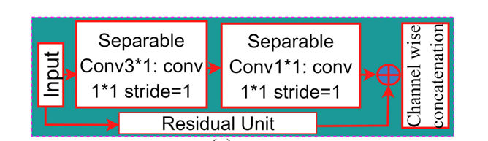
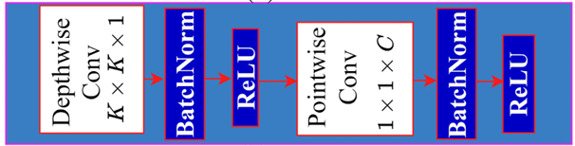
SepTCN
INTERNAL STRUCTURE OF THE SEPARABLE TCN

Slide 18
D.GRAPH CONVOLUTION WITH ATTENTION (GCA) MODULE
Purpose: Extract local and global spatial-temporal features.
Components:
Graph Convolution Layer: Enhances long-range dependencies.
Deep Learning Layers: Batch normalization, ReLU, and dropout for short-range dependencies.
Channel Attention Layer: Enhances channel-wise effective features.

Slide 19
1.GRAPH CONSTRUCTION
Dynamic Datasets: Sequences of frames with 2D joint skeleton vectors.
Graph Formation:
Nodes: Joint skeleton information.
Edges: Natural joint connections.
Objective: Generate higher-level feature maps via spatial-temporal graph convolution with attention (GCA).

Slide 20



Graph Structure:
Fully connected with N= 67 nodes.
Equation:
,V (vertices) and E (edges).
Vertices defined by the skeletal points:
Weighted adjacency matrix representing edges between nodes:

Slide 21
2.GRAPH CONVOLUTION
Purpose: Process graph-structured data, such as joint skeletons, to extract features and patterns.
Concept: Aggregate information from neighboring nodes to update the central node's features through multiple layers.
Input: Sequence of frames (Vt​) with N joint skeleton nodes at time t.

Slide 22
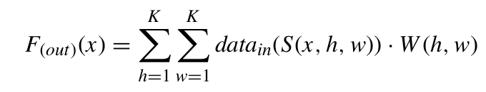
General Convolutional Neural Network (CNN) Equation:
x: Spatial location for a single channel
S: Sampling function
W: Weight function.

Slide 23
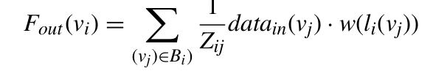
Graph Convolution Equation:
Z: Normalization term to balance node contributions
Bi​: Subset of nodes for mapping
w(⋅): Weight matrix.

Slide 24
3.CHANNEL ATTENTION
Purpose: Enhance important channel-wise features.
Process:
GCAR processes motion features through deep learning layers.
Produces a feature matrix with multiple channels.
Mechanism:
Generates a weighted feature map using global average pooling.
Fully connected layers normalize and activate the features.
Creates a weight vector to emphasize important features.

Slide 25
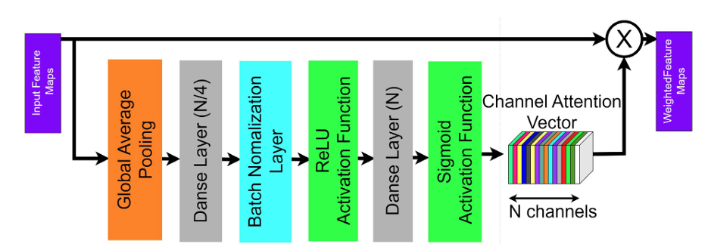
Output:
Adjusted GCAR features
Enhanced important ones

Slide 26
E.MULTI-STAGE OF GRAPH CONVOLUTION WITH ATTENTION AND RESIDUAL CONNECTION (GCAR) APPROACH
Components:
Graph Convolutions with Channel Attention (GCA) modules
Includes graph convolutional layers, ReLU, batch normalization, dropout, and channel attention
Process:
Inputs motion feature output
Concatenates third GCA output with residual connection

Slide 27
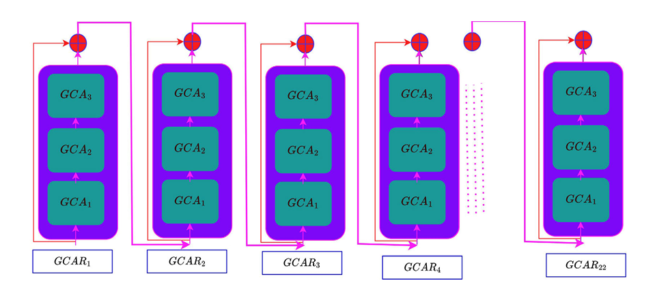
MULTI-STAGE GCAR APPROACH contd…
22 sequential GCAR modules used

Slide 28
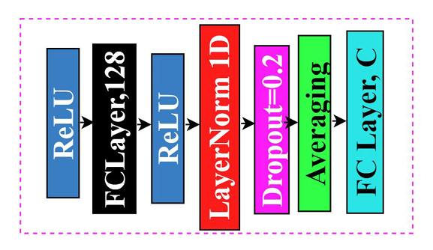
F.CLASSIFICATION MODULE
Final feature fed to this module to refine feature and classification
Components:
ReLU activation
Fully connected layer
Batch normalization
Dropout layer
Averaging

Slide 29
DATASETS
WLASL Dataset
Largest ASL dataset
2000 signs, 21089 videos, 10.5 videos per sign
Single word annotations
MSL Dataset
Mexican Sign Language Dataset
30 signs, 3000 videos, 20 videos per sign

Slide 30
DATASETS contd…
ASLLVD Dataset
American Sign Language Lexicon Video Dataset.
2,745 signs, 9748 videos, 3-4 videos per sign.
Multiple angles, ID labels for sign variations .
PSL Dataset
Pakistani Sign Language Dataset
19 signs, 2700 videos, 55 videos per sign.

Slide 31
RESULTS
Experimental Setting
Dataset Splitting: Training (70%) and testing (30%)
Training: Learning rate 0.003
Evaluation Metric
Metric: Mean top-K classification accuracy (K=1, 5, 10)
Contextual information corrects misclassifications.

Slide 32
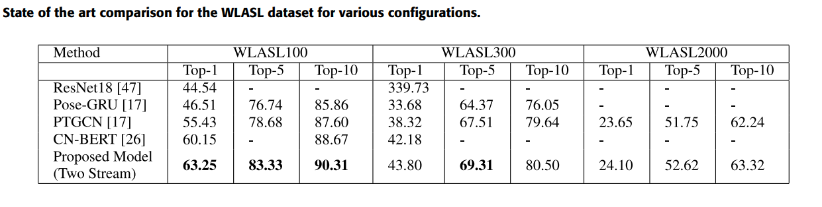
RESULTS contd…

Slide 33
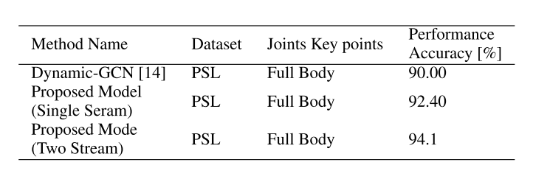
RESULTS contd…
State of the art comparison for the PSL dataset for various configurations

Slide 34
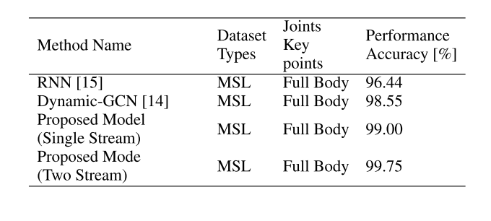
RESULTS contd…
State of the art comparison for the MSL dataset for various configurations

Slide 35
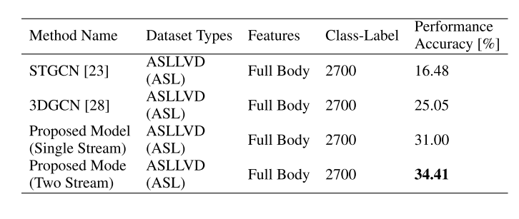
RESULTS contd…
State of the art comparison for the ASLLVD dataset for various configurations

Slide 36
CONCLUSION
GCAR Model: Two-stream multistage architecture for spatial-temporal feature extraction.
First Stream: Utilizes joint skeleton points.
Second Stream: Processes joint motion information and fuses with the first stream.
Performance: High accuracy on large-scale sign language datasets.
Future Scope: Enhancing accuracy with multi-camera recognition for practical applications.

Slide 37
REFERENCES
A. S. M. Miah, M. A. M. Hasan, Y. Tomioka and J. Shin, "Hand Gesture Recognition for Multi-Culture Sign Language Using Graph and General Deep Learning Network," in IEEE Open Journal of the Computer Society, vol. 5, pp. 144-155, 2024
J. Shin, A. S. M. Miah, K. Suzuki, K. Hirooka and M. A. M. Hasan, "Dynamic Korean Sign Language Recognition Using Pose Estimation Based and Attention-Based Neural Network," in IEEE Access, vol. 11, pp. 143501-143513, 2023
N. Naz, H. Sajid, S. Ali, O. Hasan and M. K. Ehsan, "Signgraph: An Efficient and Accurate Pose-Based Graph Convolution Approach Toward Sign Language Recognition," in IEEE Access, vol. 11, pp. 19135-19147, 2023
S. M. Saqlain Shah, H. Abbas Naqvi, J. I. Khan, M. Ramzan, Zulqarnain and H. U. Khan, "Shape Based Pakistan Sign Language Categorization Using Statistical Features and Support Vector Machines," in IEEE Access, vol. 6, pp. 59242-59252, 2018.

Slide 38
THANK YOU

